Slide 1
Identifying multi-layer gene regulatory modules from multi-dimensional genomic data (restricted in eukaryotic gene expression)

Slide 2
Background
What is multi-layer genomic data?
Same set of samples profiled on several layers of genomic activities, such as copy number variation (CNV), DNA methylation(DM), GE and microRNA expression (ME).
What is multi-layer gene regulatory module?
A module contains sets of regulatory factors from different layers that are likely to jointly contribute to a gene expression(GE) process.
We call the Multi-Dimensional Regulatory Module(MDRM) in this paper.
Target?
Find MDRMs from multi-layer genomic sample data.

Slide 3
Meaning & Motivate
Meaning:
Study the cross-layer regulatory interplay rather than single layer.
Specifically, revealed the couple impact of multi-layer activities on expression of important oncogenes and tumor suppressor genes.
CNV+DM+ME+…Other layers -> GE
Motivation:
More than 2 layers.
Consider the internal sparsity of genomic activity inside layer.

Slide 4
Paper’s work
Target: Find MDRMs from input data.
Method: sMBPLS cooperate with MBPLS
Input data: simulated data & real data
real data: 230 samples including CNV, DM, ME and GE.
Source: Cancer Genomic Atlas(ovarian cancer datasets) from TCGA & NCI60.
Conclusion towards results:
On simulated data: Have better accuracy than non-sparse approch.
On real data: The output have significant functional and transcriptional enrichment higher than those using single type of genomic data.

Slide 5
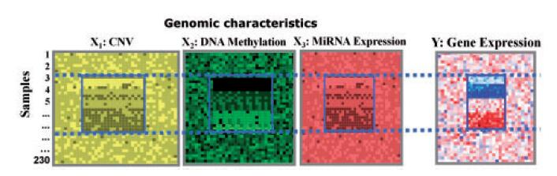
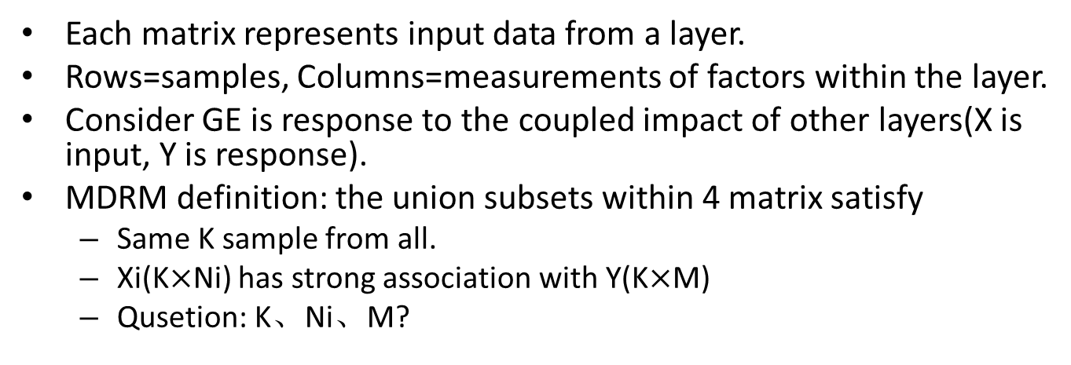
Basic model
Each matrix represents input data from a layer.
Rows=samples, Columns=measurements of factors within the layer.
Consider GE is response to the coupled impact of other layers(X is input, Y is response).
MDRM definition: the union subsets within 4 matrix satisfy
Same K sample from all.
Xi(K$×$Ni) has strong association with Y(K$×$M)
Qusetion: K、Ni、M?

Slide 6
MBPLS
PLS:
Partial Least Squares regression, 最小二乘
求两个样本集的相关性.
求两个向量的相关性.
MBPLS:
Multi-Block PLS, 多矩阵的最小二乘
多个矩阵和某一个矩阵的相关性
由于是基于PLS的，因此需要：
将矩阵压缩成向量.
将多个矩阵压缩成一个向量.

Slide 7
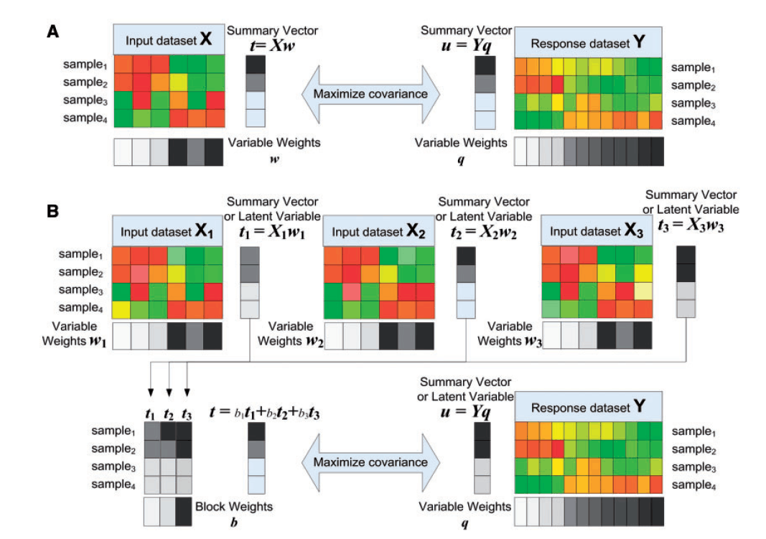

Slide 8
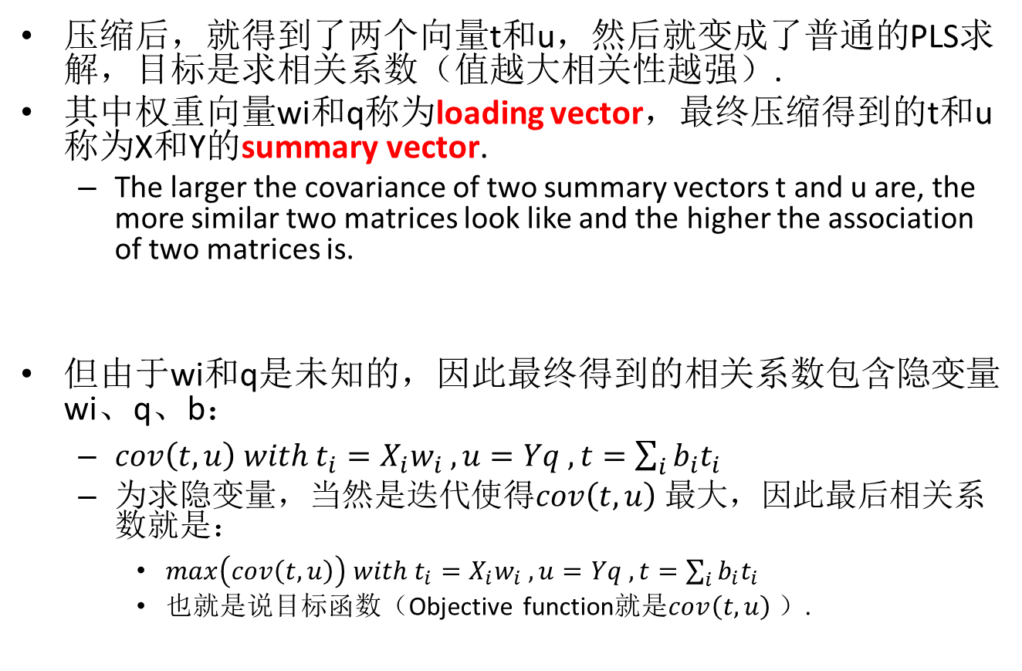
压缩后，就得到了两个向量t和u，然后就变成了普通的PLS求解，目标是求相关系数（值越大相关性越强）.
其中权重向量wi和q称为loading vector，最终压缩得到的t和u称为X和Y的summary vector.
The larger the covariance of two summary vectors t and u are, the more similar two matrices look like and the higher the association of two matrices is.
但由于wi和q是未知的，因此最终得到的相关系数包含隐变量wi、q、b：
$cov\left(t,u\right) with t_{i}=X_{i}w_{i} , u=Yq , t=\sum_{i}{b_{i}t_{i}}$
为求隐变量，当然是迭代使得$cov\left(t,u\right)$最大，因此最后相关系数就是：
$max\left(cov\left(t,u\right)\right) with t_{i}=X_{i}w_{i} , u=Yq , t=\sum_{i}{b_{i}t_{i}}$
也就是说目标函数（Objective function就是$cov\left(t,u\right)$）.

Slide 9
Problem of MBPLS
Often fails to identify distinct association signals of coherent structures.
Why?
In raw data, not all elements are effectively used to represent data.
Which means most elements taking values close to zero while only few take significantly non-zero values.
Those close-to-zero values make noise.
So, we must clear the noise in raw data at first(makes them zero forcibly).

Slide 10
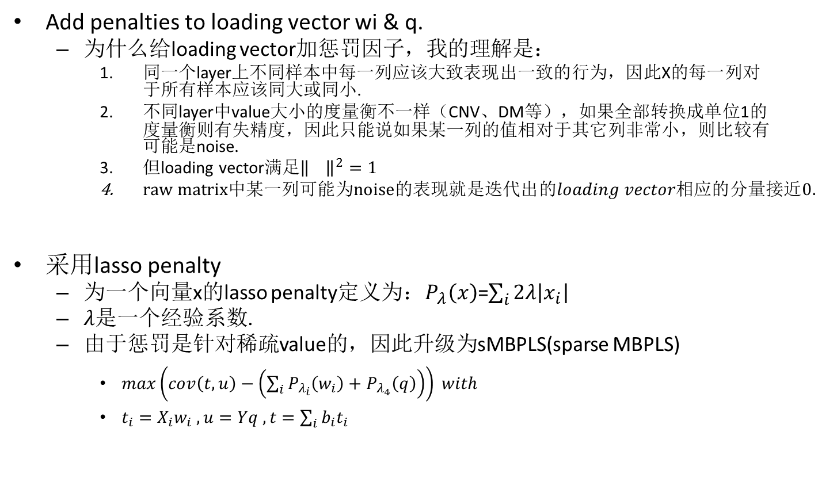
Sparse Penalty：find noise in raw data
Add penalties to loading vector wi & q.
为什么给loading vector加惩罚因子，我的理解是：
同一个layer上不同样本中每一列应该大致表现出一致的行为，因此X的每一列对于所有样本应该同大或同小.
不同layer中value大小的度量衡不一样（CNV、DM等），如果全部转换成单位1的度量衡则有失精度，因此只能说如果某一列的值相对于其它列非常小，则比较有可能是noise.
但loading vector满足${\left\|\right\|}^{2}=1$
$raw matrix中某一列可能为noise的表现就是迭代出的loading vector相应的分量接近0.$
采用lasso penalty
为一个向量x的lasso penalty定义为：$P_{λ}\left(x\right)$=$\sum_{i}{2λ\left|x_{i}\right|}$
$λ$是一个经验系数.
由于惩罚是针对稀疏value的，因此升级为sMBPLS(sparse MBPLS)
$max\left(cov\left(t,u\right)−\left(\sum_{i}{P_{λ_{i}}\left(w_{i}\right)}+P_{λ_{4}}\left(q\right)\right)\right) with$
$t_{i}=X_{i}w_{i} , u=Yq , t=\sum_{i}{b_{i}t_{i}}$

Slide 11
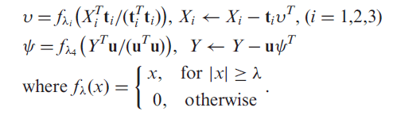
Consequent input data
利用上面两个formula更新raw matrix之后再用MBPLS跑出最终结果.
f描述了一种惩罚力度，如果力度大于经验系数就多减一点（实际的罚分），如果惩罚力度小则无罚分.
净化过的raw matrix称为deflated matrix.

Slide 12
Whole process
Raw data使用MBPLS（wi、q初始值随机生成）得到下一步sMBPLS迭代的初始wi和q.
将上一步MBPLS产出的wi、q作为sMBPLS迭代的初始值，进行MBPLS迭代.
根据sMBPLS的结果净化raw data.
用净化后的raw data使用MBPLS算出最终的cov.

Slide 13
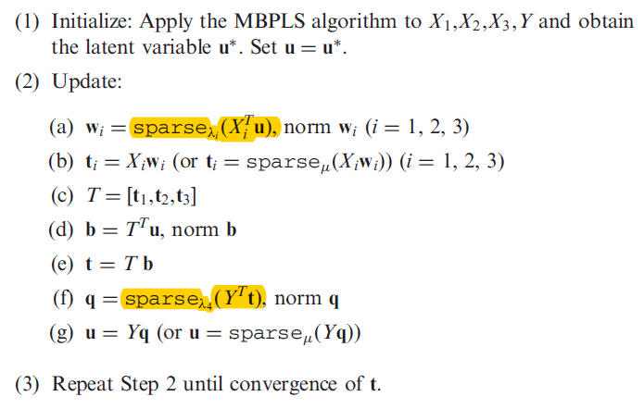
Iteration algorithm

Slide 14
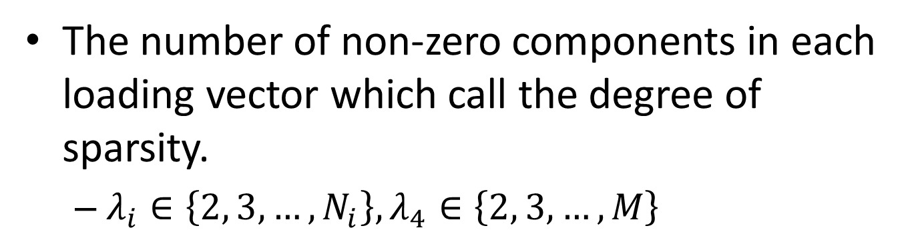
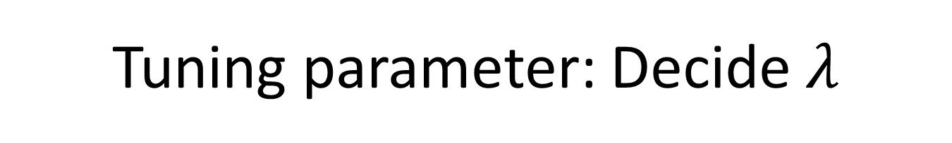

Tuning parameter: Decide $λ$
The number of non-zero components in each loading vector which call the degree of sparsity.
$λ_{i}∈\left\{2, 3, …, N_{i}\right\}, λ_{4}∈\left\{2, 3, …, M\right\}$
foreach $λ_{1} \{$
foreach $λ_{2} \{$
foreach $λ_{3} \{$
foreach $λ_{4} \{$
// test algorithm…
}
}
}
}

Slide 15
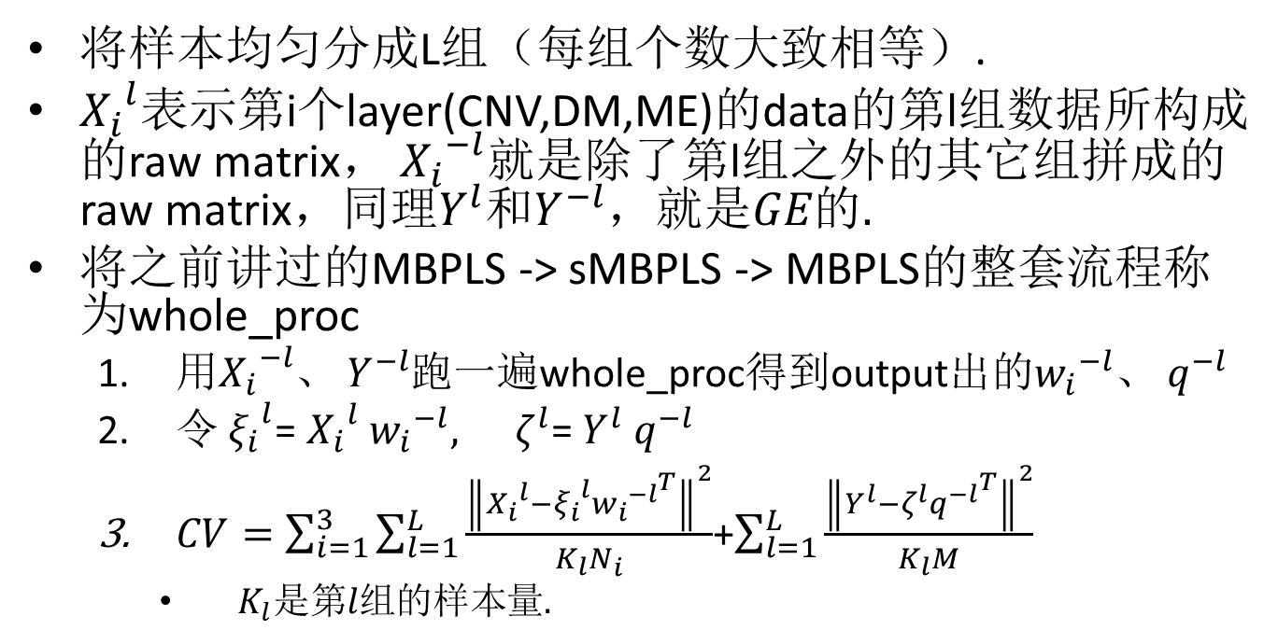
Test algorithm
将样本均匀分成L组（每组个数大致相等）.
${X_{i}}^{l}$表示第i个layer(CNV,DM,ME)的data的第l组数据所构成的raw matrix， ${X_{i}}^{−l}就是除了\text{第}\text{l}\text{组}$之外的其它组拼成的raw matrix，同理$Y^{l}和Y^{−l}，就是GE的.$
将之前讲过的MBPLS -> sMBPLS -> MBPLS的整套流程称为whole_proc
用${X_{i}}^{−l}$、 $Y^{−l}$跑一遍whole_proc得到output出的${w_{i}}^{−l}$、 $q^{−l}$
令 ${ξ_{i}}^{l}$= ${X_{i}}^{l}$ ${w_{i}}^{−l}, { ζ}^{l}$= $Y^{l}$ $q^{−l}$
$CV=\sum_{i=1}^{3}{\sum_{l=1}^{L}{\frac{{\left\|{X_{i}}^{l}−{ξ_{i}}^{l}{{w_{i}}^{−l}}^{T}\right\|}^{2}}{K_{l}N_{i}}}}$+$\sum_{l=1}^{L}{\frac{{\left\|Y^{l}−ζ^{l}{q^{−l}}^{T}\right\|}^{2}}{K_{l}M}}$
$K_{l}是第l组的样本量.$

Slide 16
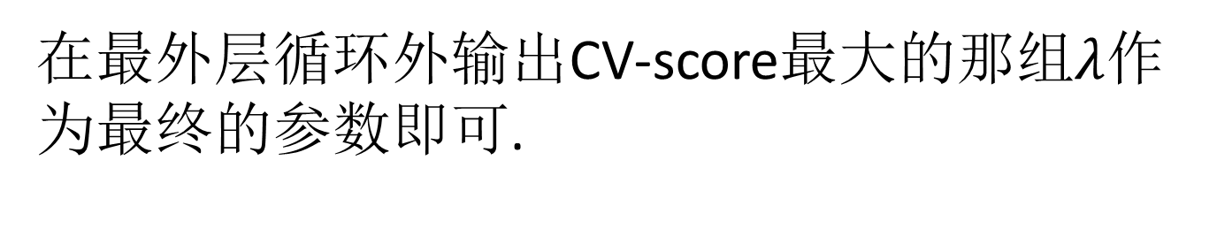
在最外层循环外输出CV-score最大的那组$λ$作为最终的参数即可.

